Slide 1
Objectives
To define Agent and its structure
To understand environment and nature of environment
To learn different types of agents
Simple reflex agent
Model-based reflex agent
Goal-based agents
Utility-based agents
Learning agents

Slide 2
What is an Agent?
Agent is something that perceives its environment through sensors and acts upon that environment through effectors or actuators.
To understand Agent, We need to know Meaning of
Sensors
Effectors
Actuators
Perception
Action
Environment

Slide 3
An Agent
Simple example of Agent: Consider human as an agent
Sensors : Eyes, Nose, Skin(touch), Tongue, Ears
(sensors sense the environment and passes it to the processing unit)
Effectors/Actuators : Hands, Legs, Mouth(speak)
(Effectors/Actuators are the tools by using which agents acts upon the environment)
Perception: collection of information from environment through sensors
(The way in which something is regarded, understood, or interpreted)
Action: is the output given to the environment from agent
Environment: the surroundings or conditions in which a agent operates

Slide 4
An Agent
Consider Robot as an agent
Sensors : Cameras, infrared range finders, sound recorders
Effectors/Actuators : Motors, Output screens, printing devices

Slide 5
An Agent
Agent is not only a robot
It may be a program
It may be a software
It may be any physical device (e.g. automated driving car)
It may be a any specific hardware(robotic arm)
e.g. opponent of computer game

Slide 6
Agents Terminologies
Performance of Agent: It is the criteria, which determines how successful an agent is.
Behaviour of an Agent: It is the action that agent performs after any given sequence of percept's.
Percept: It is agent’s perceptual inputs at a given instance.
Percept Sequence: It is the history of all that an agent has perceived till date.

Slide 7
Agent function
An agent function is the description of what all functionalities the agent is supposed to do/perform
The agent function provides mapping between percept sequence to the desired actions

Slide 8
Agent Program
An agent program is a computer program that implements agent function in an architecture suitable language
Agent programs needs to be installed on a device in order to run the device accordingly(e.g. AC, Freeze, remote control etc.)
The device must have some form of sensors to sense the environment and actuators to act upon it.
Hence agent is a combination of the architecture hardware and software program
Agent=Architcure(Hardware)+Program
Lets discuss example of vacuume cleaner in detail

Slide 9
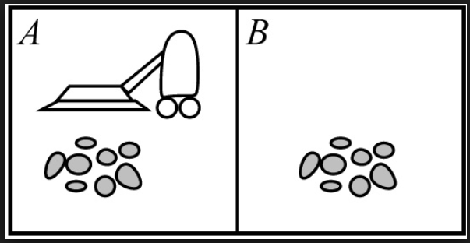
Vacuume cleaner agent
Lets understand how to represent the
percept's(inputs) and actions(output) used in
case of a vacuume cleaner.
Suppose there are two blocks (A and B having some dirt) as shown in diagram
To clean the room, Vacuume cleaner agent suppose to sense the dirt and collect it
In order to do that agent must have camera to see dirt and a mechanism to move forward, backward, left and right to reach to the dirt
Also it should have a mechanism to absorb the dirt

Slide 10
Vacuume cleaner agent
Based on the percept action will be
Performed. E.g Move left, Move right,
Absorb, No operation etc.
Sensor for the vacuume cleaner agent can be camera, dirt sensor
Actuators are Motors to move and absorption mechanism
The operations can be represented by
[A,Dirty],[B,Clean],[A,Absorb],[B,Nop] etc.

Slide 11
Structure of Intelligent agent
Q. What is intelligent agent? explain the structure of intelligent agent?
Intelligent Agent:
It is the one which can take input from the environment through its sensors and acts upon the environment through its actuators. Its actions are always directed to achieve goal
Basic abilities of intelligent agent are:
To remain autonomous(self-governed)
Responsive
Goal-oriented

Slide 12
Structure of Intelligent agent
Observe the input
Perception
Scan DB for corresponding action
Enviro-nment
Agent
Database of input and actions
Action
Action is given as output
Set internal state to the appropriate action

Slide 13
Structure of Intelligent agent
The agent first observes the environment through its sensors and get the input
Environment may change
Then scans the DB of inputs and actions (for corresponding action)
e.g. hot pan
The agent keeps taking input from the environment and goes through these states every time
Agent’s structure can be viewed as:
Agent = Architecture + Agent Program
Architecture = the machinery that an agent executes on.
Agent Program = an implementation of an agent function.

Slide 14
Environment and its types
Environment is nothing but the surroundings or conditions in which an agent operates
Fully Observable Vs. Partially Observable
Single agent Vs. Multiple agents
Deterministic Vs. Non-deterministic
Episodic Vs. sequential
Static Vs. Dynamic
Discrete Vs. Continuous
Known Vs. Unknown

Slide 15
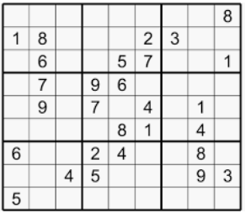
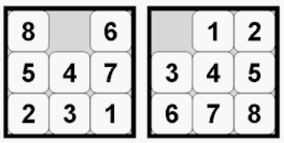
Environment types: Fully Observable Vs. Partially Observable
In fully observable environments agents are able to gather all the necessary information required to take actions.
Agents don’t have to keep records of internal states
e.g. 8-puzzle problem, Sudoku puzzle etc.

Slide 16
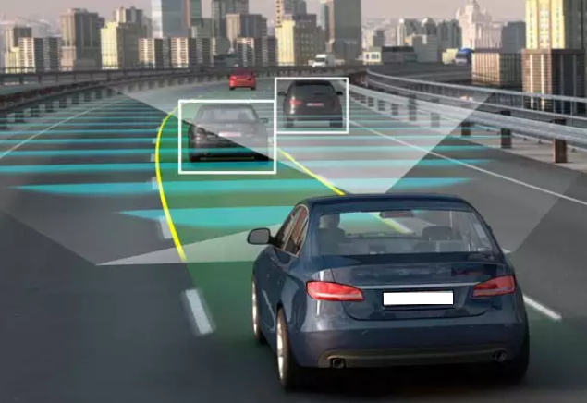
Environment types: Fully Observable Vs. Partially Observable
Environments are called partially observable when sensors can not provide errorless information as the environment is not seen completely at any point of time
e.g. automated car (can not predicts what the other drivers are thinking)

Slide 17
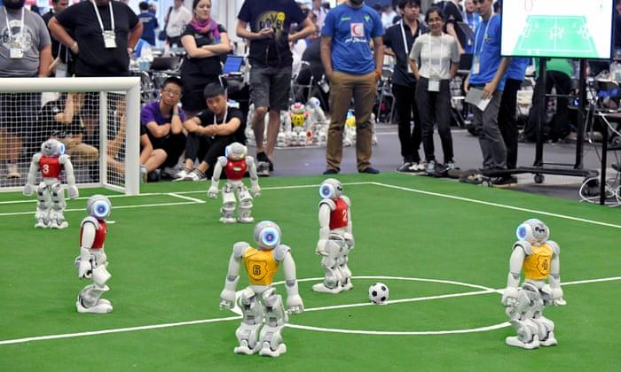
Environment types: Single agent Vs. Multiple agents
It is based on the number of agents acting in the environment
In single agent environment the agent operating on its own
e.g. vacuume cleaner agent
In multiagent environment an agent operates in collaboration with other agents
e.g. automated car driving agent(multiple agents driving on road)

Slide 18

Environment types: Deterministic Vs. Non-deterministic
If the next state of the environment is completely determined by the current state and the actions of the agent, then the environment is deterministic
e.g. chess game
(next step is depend on current state)
The next state of the environment is not depends on the current state, and there are few changes happening in the environment irrespective of the agents action
e.g. automated car driving system(can not control the traffic conditions on the road)

Slide 19
Environment types: Episodic Vs. sequential
An episodic task environment is the one where each of the agents action is divided into episodes
The current episode is different than the previous episode and there is no dependency between them
In each episode the agent receives an input from environment and then perform a corresponding action
e.g. classification tasks (pick up and place from the conveyor belt)
every time agent will check assembled parts of a component and acts
In sequential environments the previous decision can affect all future decisions
The next action of the agent depends on what action he has taken previously
e.g. if automatic car driving agent is initiating breaks then he has to release accelerator, press clutch and lower down the gear as next actions

Slide 20
Environment types: Static Vs. Dynamic
If an environment remains unchanged while the agent is performing given task then it is called as a static environment
e.g. vacuume cleaner environment, Sudoku puzzle environment
If the environment is not changing over the time but an agents performance is changing then it is called as semi-dynamic environment.
e.g. chess game
If the environment changes while an agent is performing some task then it is called dynamic environment.
e.g. automatic car driving agent

Slide 21
Environment types: Discrete Vs. Continuous
When there are distinct and clearly defined inputs and outputs then it is called discrete environment.
e.g. chess environment has finite number of distinct inputs and outputs/actions
When there are continuous inputs from environment and action can not be defined/predicted then it is called continuous environment
e.g. Automatic car driving system

Slide 22
Environment types: Known Vs. Unknown
In known environment the output of all probable actions is given
e.g. tic-tac-toe game
In unknown environment agent has to find output, make decisions and it has to gain knowledge about- how the environment works.
e.g. automated car driving agent

Slide 23
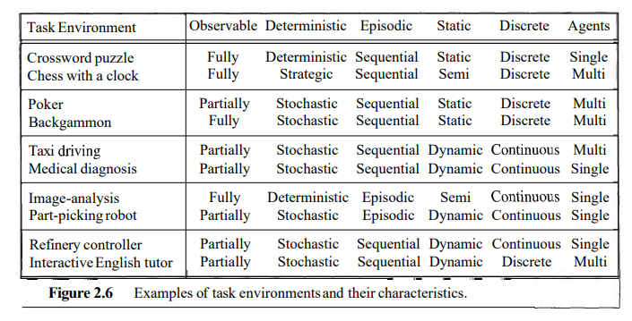

Slide 24
PEAS Properties
What is PEAS stands for
P: Performance Measure (what is the expected output)
E: Environment
A: Actuators/Effectors
S: Sensors

Slide 25
PEAS Properties of Automated Taxi Driver Agent
P: Performance Measure (what is the expected output)
Getting to correct Destination
Less cost
High Safety
E: Environment
Varity of roads
Traffic
Different types of passengers
A: Actuators/Effectors
Accelerator
Steering
breaks
S: Sensors
Camera
GPS
IR sensors

Slide 26
PEAS Properties of Medical Diagnosis System
P: Performance Measure (what is the expected output)
Healthy Patients
Minimum cost
E: Environment
Patients
Doctors
Hospital
Staff
A: Actuators/Effectors
Screen display, printers
Questions test
Treatment
S: Sensors
Keybord (entry of symptoms)

